Slide 1












GOOGLE CLOUD
Arcade Program

Slide 2

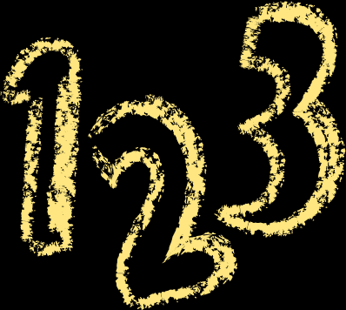
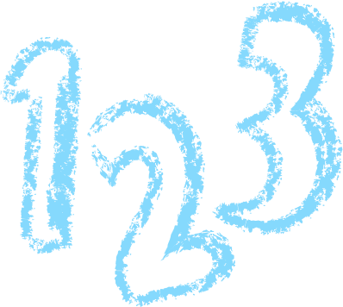

1. What is Google Cloud Arcade Program?
2. Why should you join & what's its importance?
3. Who can join?
4. Any prerequisites?
5. Differences between Google Cloud Arcade and Facilitator Program?
6. How to register in this program?
7. How to complete points faster?
8. Time duration of Arcade Program
9. When and how to redeem Google Cloud Swags?
10. How much time will it take to achieve your cool swags?
IMPORTANT
TOPICS

Slide 3



WHAT IS GOOGLE CLOUD ARCADE PROGRAM ?
Google Arcade is built around Google Cloud Skills Boost, where participants complete labs, skill badges, and trivia challenges related to technologies like BigQuery, Firebase, Kubernetes, and AI/ML. It transforms technical training into a game-like experience — completing different activities earns Arcade Points, which unlock levels, rewards, and swag.

Slide 4







WHY SHOULD YOU JOIN?
CLOUD TECHNOLOGY
BOOST RESUME
JOBS & INTERNSHIPS
FREE REWARDS
Learn various cloud technologies like BigQuery, Firebase, AI/Ml etc.
It helps to boost your resume by showcasing your cloud skills.
You can get jobs and internships by showing these skills.
You will get Free Swags by completing the labs.

Slide 5
WHO CAN JOIN ?
Anyone can join! Students, working professionals, and even beginners are welcome — no age or experience limits.

Slide 6






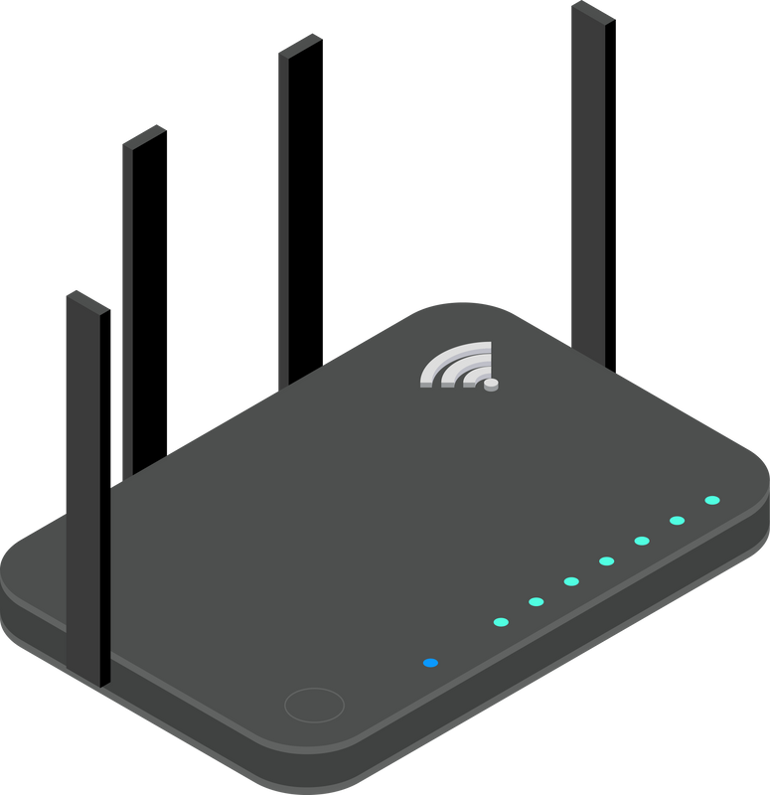
ANY PREREQUISITES ?
Laptop or Personal Computer
Internet Connection

Slide 7





ARCADE PROGRAM AND FACILITATOR PROGRAM
ARCADE PROGRAM
FACILITATOR PROGRAM
Open for everyone.
self-paced learning,
2 times in a year
earn badges, points, and swags.
Special campaign,
help and mentor you.
Fixed Time Dureation
(Upto 2 months).
Community & Help

Slide 8
HOW TO REGISTER IN THIS PROGRAM?

Slide 9






POINT SYSTEM
LEVEL GAMES
SPECIAL GAMES
TRIVIA GAMES
SKILL BADGES
1 POINTS
2-3 POINTS
1 POINTS
0.5 POINTS
You will get Three Level Games in a month
Each Level Games consistes of 8-12 Labs.
On Completing 1 level game you are rewarded with 1 Point.
Special Games comes during special event
(3 points).
Each Month you get a Special Game (2 Points)
You will get FourTrivia Games in a month
Each Trivia Games consistes of 4 Labs.
On Completing 1 Trivia game you are rewarded with 1 Point.
Each Skill Badge consistes of 4-6 Labs.
On Completing 2 Skill Badge you are rewarded with 1 Point.

Slide 10
HOW TO COMPLETE POINTS FASTER?

Slide 11
WHEN AND HOW TO REDEEM GOOGLE CLOUD SWAGS?

Slide 12
HOW MUCH TIME WILL IT TAKE TO GET YOUR SWAGS?

Slide 13



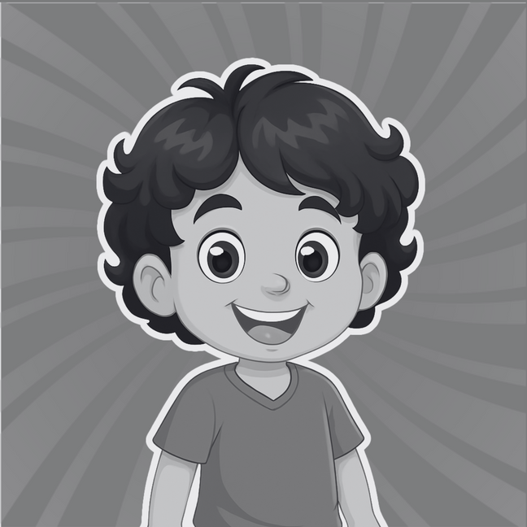
Connect with me on LinkedIn and let’s grow our professional network together!
Connect with me on LinkedIn and let’s grow our professional network together!
OUR COMMUNITY
YOUTUBE
LINKDIN
TELEGRAM
To guide and help you will provise complete tutorial of labs.
Connect with me on LinkedIn
And Let’s grow our professional network together!
Join our Telegram Group for your doubts and queries related to labs
and for discussion.
@TechCode9
@prateekrajput08
@techcode9

Slide 14
LET’S HAVE A
GREAT YEAR!

